Slide 1
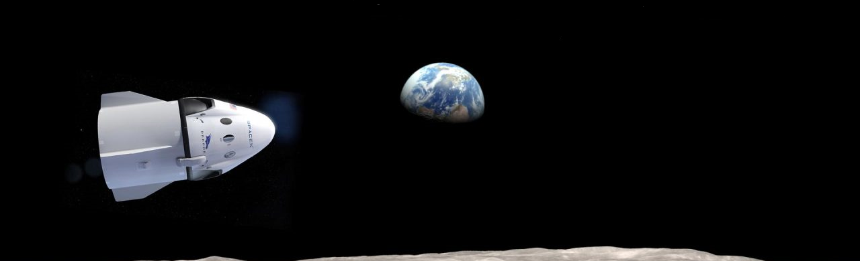
Office…
Going to office is now became like going to Mars,
so we made the space pod for you…. Hang on…
My_space_pod _
- By Team Fiesta
Astronauts
Sathiya Govindaraj
Devarajan, Archana
B, Vidya Laxshmi
Suez Malchira Biddappa

Slide 2
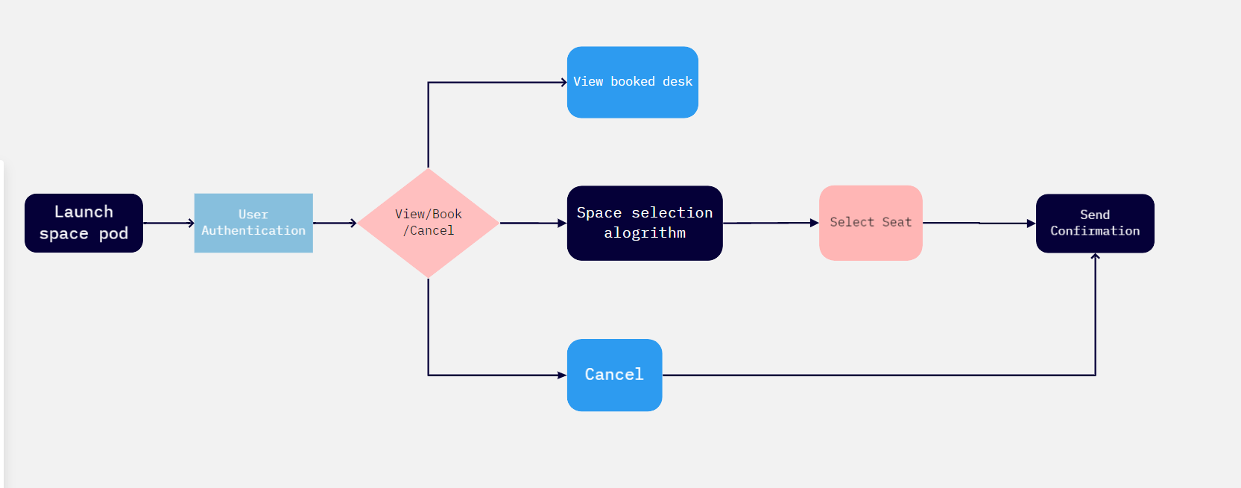
Simple user flow:-

Slide 3









Application Architecture
DB2
MySpacePod
Cloud Object

Slide 4
Application Architecture and tech.
IBM Watson chat assistance.
Floor map based space selection algorithm
.NET Web API
Node.js for Webhook Integration
IBM DB2 for backend
Cloud Object Storage service.

Slide 5
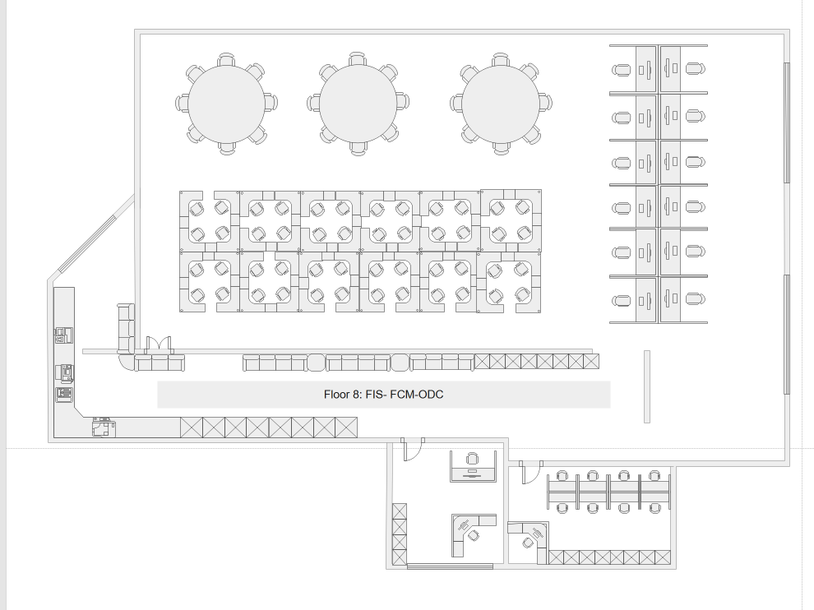
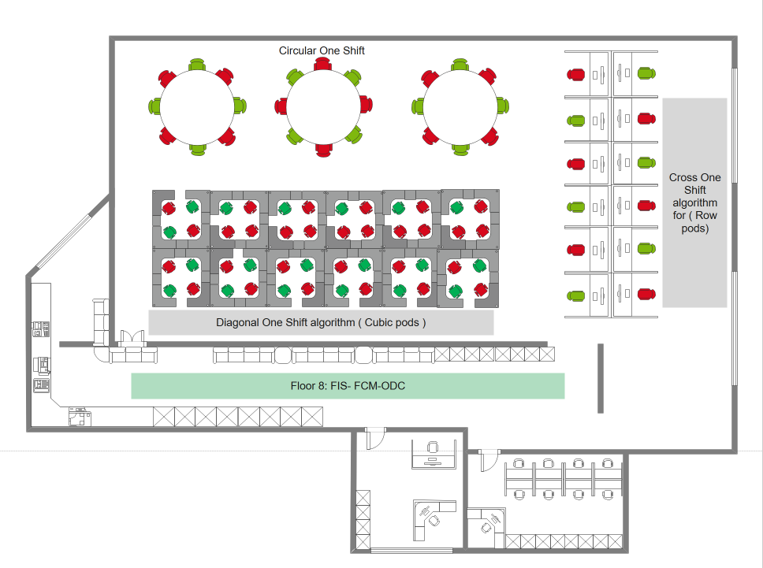
Floor plan comparison

Slide 6
After applying Algorithm

Slide 7
Features - MySpacePod
Launch MySpacePod
Authenticate using Employee ID
Book/View/Cancel
View already booked seat
Book another seat in same location
If unavailable
Book Employee’s Permanent seat
Cancel a seat
If unavailable
Book a seat in different location

Slide 8
Features of the MySpacePod
Access Restrictions for Unbooked Employees
Easy identification of Covid 19 people and their cluster
Attendance of the employees can be managed.
Seat allocation in few clicks.
Effective algorithms designed for handling the Master Seat mapping

